Slide 1
Zomato Restaurant Reviews Teal Rabbits
Ashley Drayton, Babette Blanquet, Benedict Nathaniel, Erica Wearne

Slide 2
Zomato Restaurant Reviews Teal Rabbits Summary
Hypothesis:
We always believe Melbourne is the cultural capital in Australia and is renowned for its fine dining.
We are going to explore to top restaurants across the five largest cities to confirm whether Melbourne is really the best! ☺
Findings:
Almost 50% of the top 100 restaurants in Australia are in Melbourne.
Melbourne Top 100 restaurants have on average a slightly higher rating than the other cities.
However the average cost for two people in Melbourne’s Top restaurants is $20 more than the top restaurants in Sydney and $40 higher than the other cities.
The variety of cuisines is similar in all cities.
So Melbourne restaurants can be seen as the best based on user ratings, but you have to spend more. Either Melbournians love their restaurants and are ready to pay more. Or because Melbourne is renowned for its fine dining, top restaurants can charge more for it.

Slide 3
Zomato Restaurant Reviews Teal Rabbits The Data
We used Zomato API to gather the data.
Challenges
Search of 100 restaurants maximum per call.
We actually wanted a 1000 per city instead.
Our dataset = 500 restaurants
Top 100 restaurants of Melbourne, Sydney, Brisbane, Adelaide, Perth
Biases
Risk of biases as some other excellent restaurants can be in country Australia.
We were interested in best restaurants where most Australians live.
Cleaning the data
The data was really clean
Removal of three rows due to ‘Average Cost for two’ not relevant
22 missing Zip codes – didn’t remove the rows as we didn’t need them for our analysis

Slide 4
Clean up

Slide 5
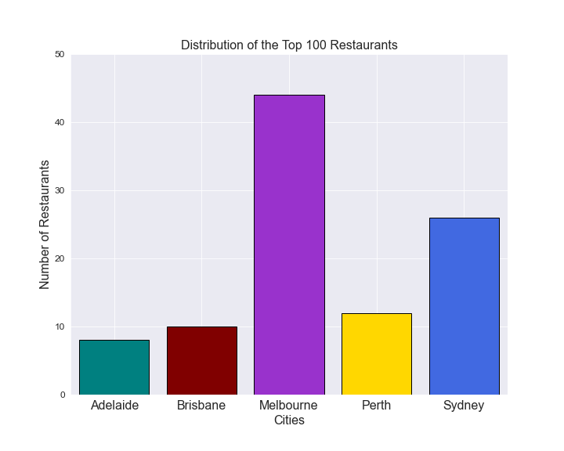
Zomato Restaurant Reviews Teal Rabbits Distribution of the Top 100 Restaurants in Australia
Almost 45% of the Top 100 Restaurants are in Melbourne. Other cities fall a long way behind.
This may be reflective of a disproportionate number of restaurants in other cities however our data is unable to confirm this.

Slide 6
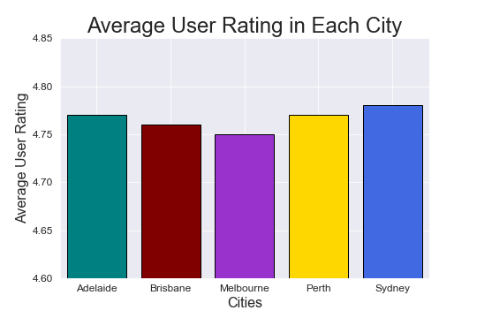
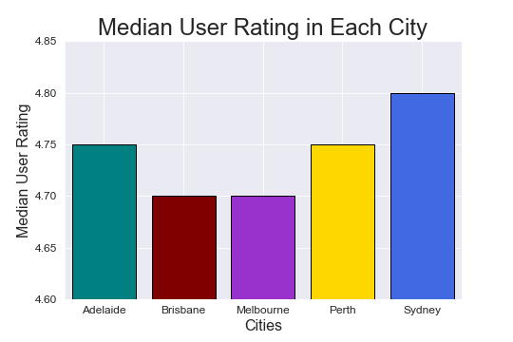
Zomato Restaurant Reviews Teal Rabbits Average vs Median User Rating by City Across the Top 100 Restaurants
Melbourne already lags behind in average user ratings across the Top 100 restaurants in Australia however the difference is magnified when median user rating is considered.

Slide 7
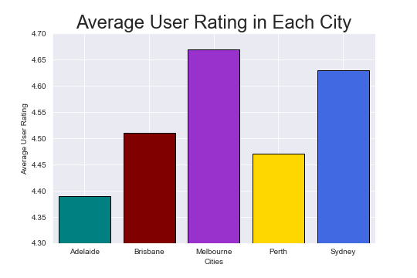
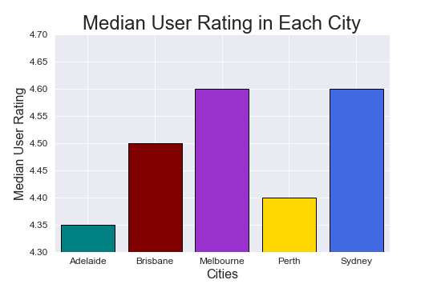
Zomato Restaurant Reviews Teal Rabbits Average vs Median User Rating by City Across the Top 500 Restaurants
When doing the comparison of the top 500 restaurants however, Melbourne is ahead on average user ratings and equal with Sydney on median user rating.

Slide 8
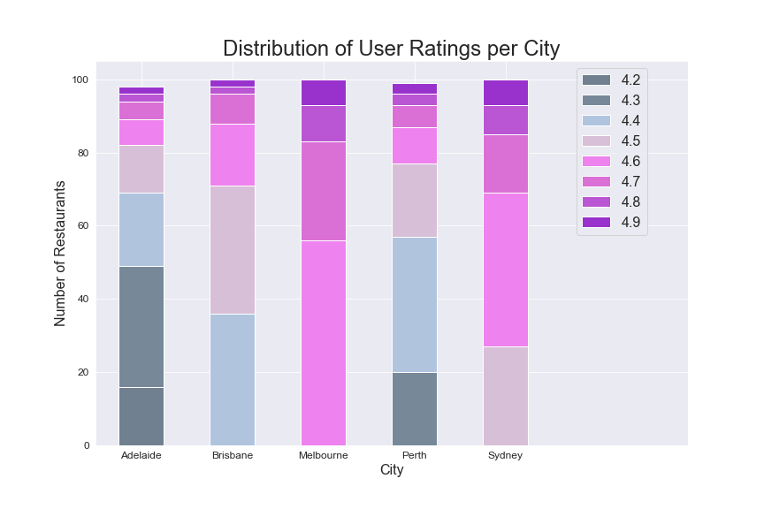
Zomato Restaurant Reviews Teal Rabbits User ratings across top 500 restaurants in each city
Melbourne and Sydney have a slightly higher ratings than other cities.
The Top 500 restaurants in Melbourne have a rating >= 4.6

Slide 9
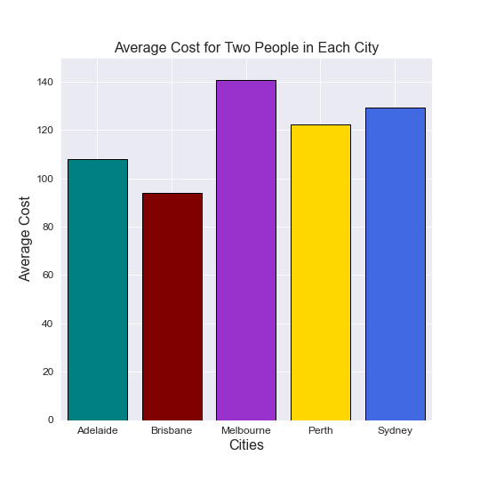
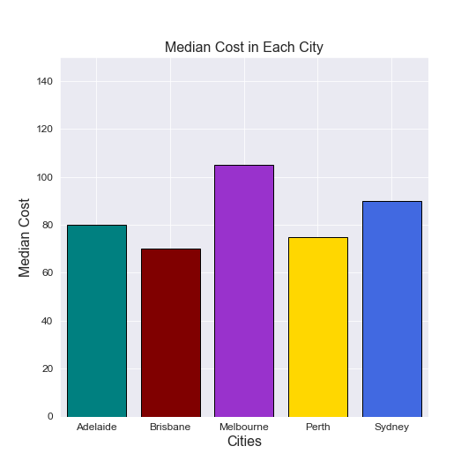
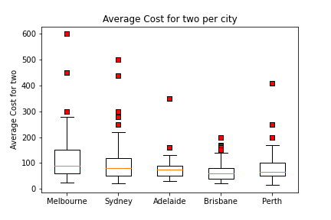
Zomato Restaurant Reviews Teal Rabbits Average vs Median Cost for Two Per City
Melbourne’s top 100 restaurants are by far more expensive than in any other city. The average cost for two is $120 compare to $90 for all Australian restaurants.
The Melbourne’s box plot shows the top interquartile is really high - it’s not only outliers that push the average cost

Slide 10
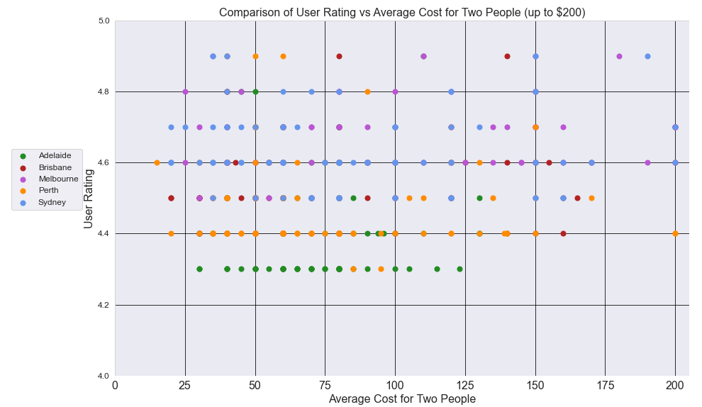
Zomato Restaurant Reviews Teal Rabbits Restaurants plotted by price, ratings and cities
Findings XXX

Slide 11
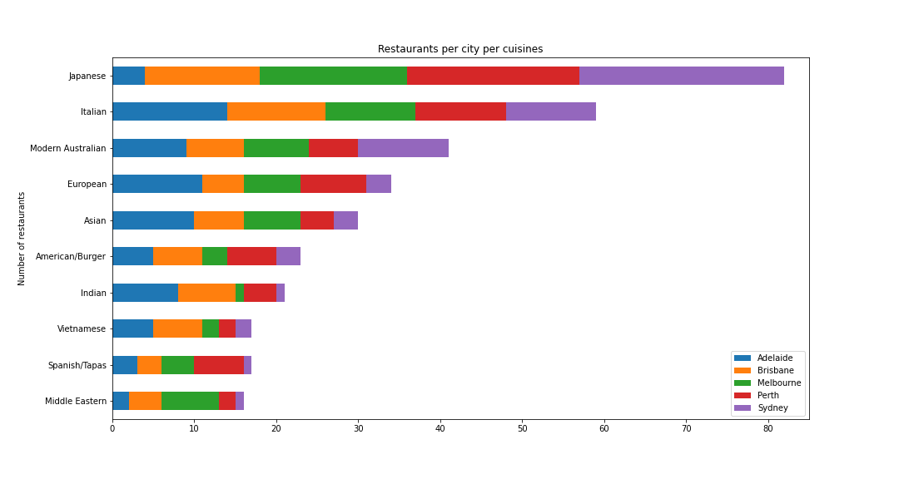
Cuisines and cities
The Japanese and Italian cuisines are the most represented among the top restaurants.

Slide 12
Discussion / Post Mortem
Summary of findings
Discuss your findings.
Did you find what you expected to find? If not, why not? What inferences or general conclusions can you draw from your analysis?
We can confirm Melbourne has a more dynamic scene due to the number of top end restaurants.
Discuss any difficulties that arose, and how you dealt with them
Discuss any additional questions that came up, but which you didn't have time to answer: What would you research next, if you had two more weeks?
We would go deeper into analysing the cuisines.

Slide 13
Questions

